Slide 1
Genesis Forms
Why use a genesis form?
Types of forms – make sure you choose the right one
Filling out the form, what to think about
What happens to the form when I hit submit?

Slide 2
Why fill out a genesis form?
Did you know?
In the fall there were:
169 main genesis forms (71 were past due)
183 Room Only forms
49 Room and Blurb
32 Offsite forms
Total 433 forms about new events coming in

Slide 3
Why fill out a genesis form?
Making a change –
339 Change requests came in Sept-Dec
What happens if fellowship knew something was changed but you didn’t have a room? Or registration? Or it communicated?
Allows all ministries to know the information
As much detail is needed so we can be sure to best help you.

Slide 4
Why fill out a genesis form?
Did you know?
In the winter there were:
134 main genesis forms (29 were past due)
81 Room Only forms
9 Room and Blurb
10 Offsite forms
Total 234 forms about new events coming in
From Jan 1-yesterday at noon = 79 change requests

Slide 5
Types of forms – make sure you choose the right one
See handout for the list: on StaffStuff
Main Form: Class/Event ****
Change Request ***
Just a room and nothing else
Room and Communication (Room and Blurb)
Offsite Class/Event
Multi-event
Transportation Request
Funeral Services
Studio Production
Mission Trip Form

Slide 6
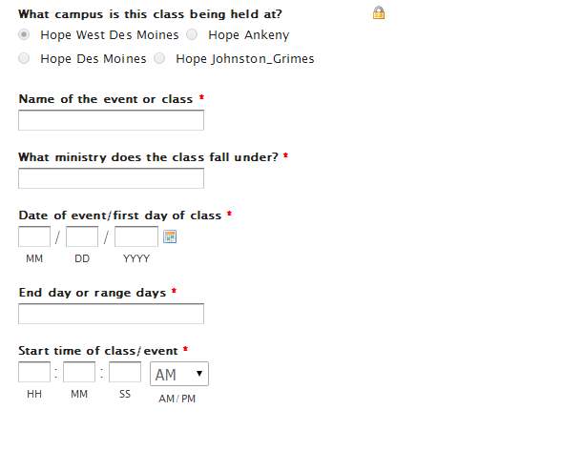
Filling out the form, (what to think about)
Make sure the title makes sense for those you want to attend
Don’t make up a ministry
Please give exact date with range ie. May 21 (6 week class)
Start of class/event not when you need the room

Slide 7
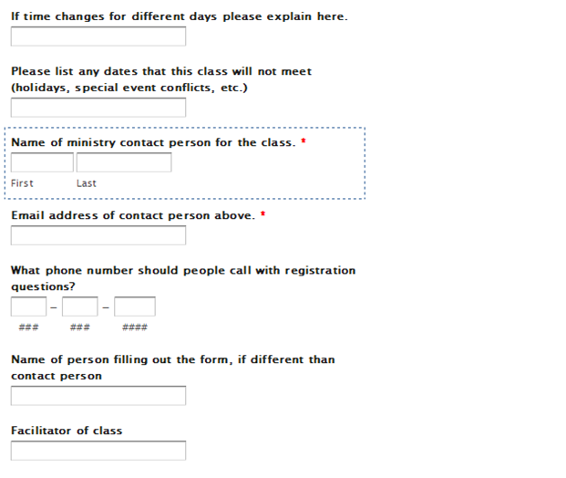
Filling out the form,
Ie. Friday and Saturday with different times
Please check a calendar when filling out so we don’t have 20 change requests during holiday.
The Ministry person who makes the decisions
WDM office, JG office, ANK office, DSM office etc.
So if there are questions about how it’s filled out the support team knows who to talk with.

Slide 8
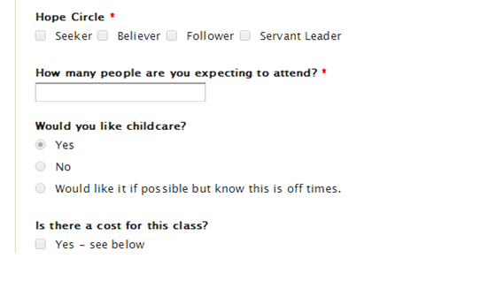
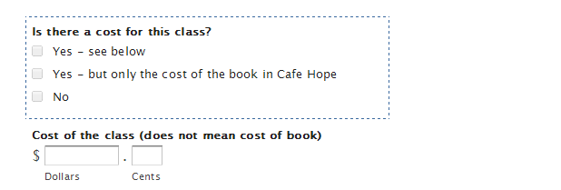
Filling out the form,
Best estimate or ask for help in deciding this.
If off hours, will need approval

Slide 9
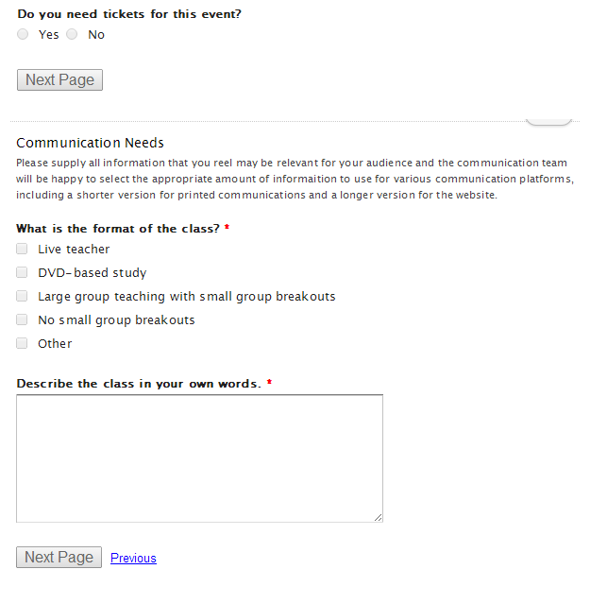
Filling out the form,
Communication has the right to veto.
This is what admin uses to figure out the type of room and verify what is needed.
Please don’t put “like last time” look it up and copy and paste.
The more detail the better as communication will edit it.

Slide 10
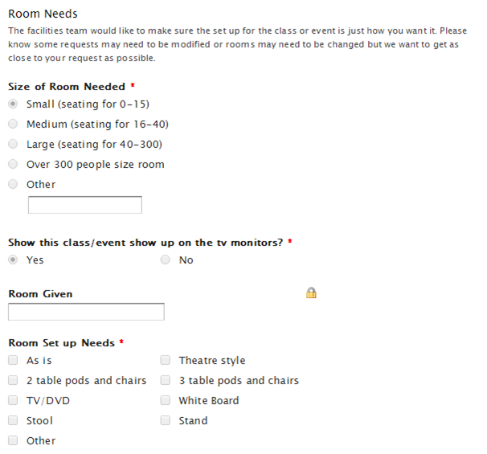
Filling out the form,
Make sure this matches with the answer of how many expecting.
This is the room assignments on the monitors by Welcome Center, not pre-service loop.
Remember as is, means whatever is in there before you, which could mean nothing or with a crazy set up.

Slide 11
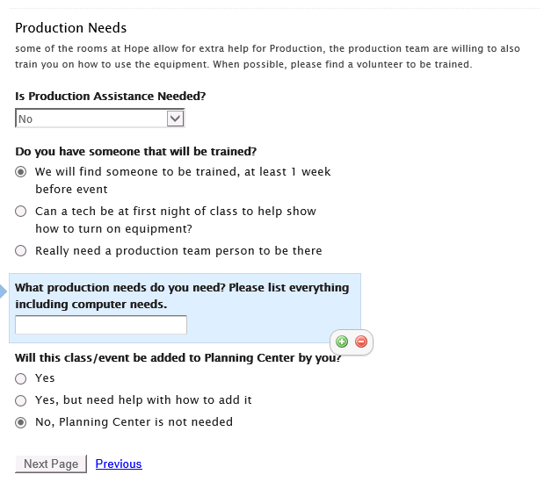
Filling out the form,
This includes all aspects of Production, computer, microphones, music etc
Production will connect with you to let you know if all options are available for your event.
The more details the better

Slide 12
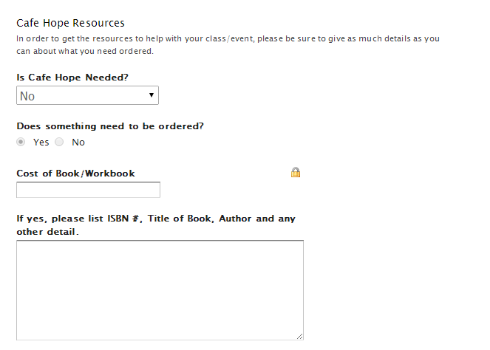
Filling out the form,
As much details about the books or what needs to be ordered the better.
Most important is to have all info
Title, author and ISBN #

Slide 13
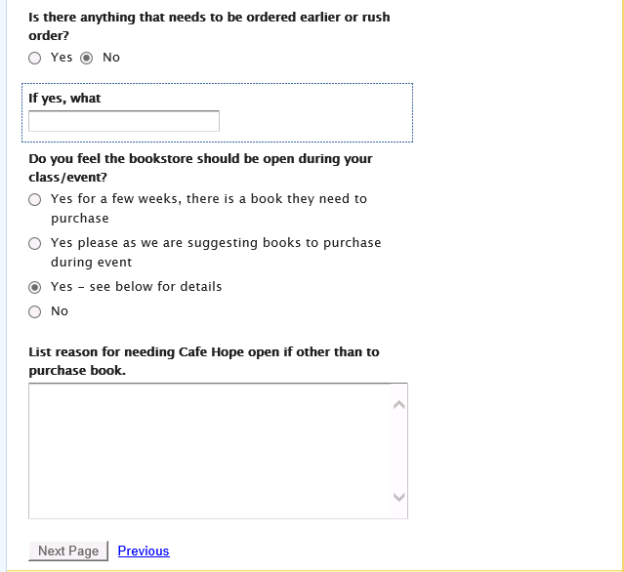
Filling out the form,
This is if you need leaders guide or something before the regular order is needed.
Please know Cindy may veto if past experience shows it may not be best resource, if needed but will do what she can.

Slide 14
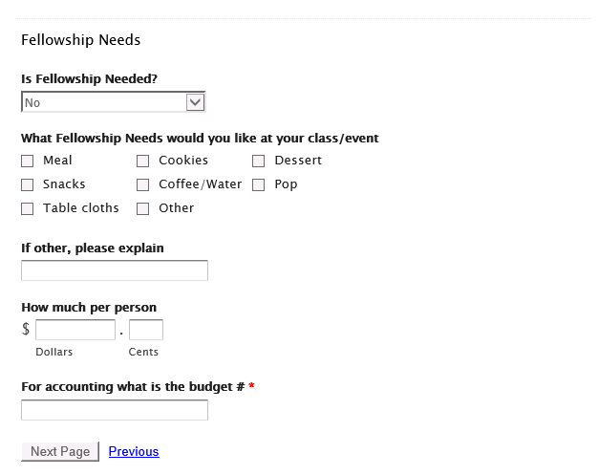
Filling out the form,
Must have 25 people to put out the request.
Please know Matt may make other suggestions if past experience shows it may not be best resource, however fellowship will work hard to help make your event successful.

Slide 15
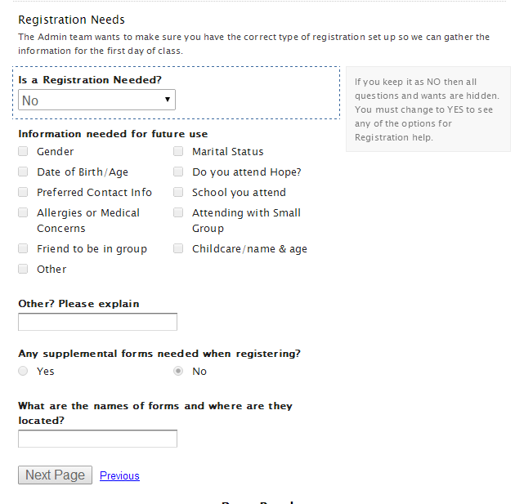
Filling out the form,
Only mark those things you will use in the future, knowing admin may add a few more things if they need it.
Attach form at end of form or list where to find on shared drive.

Slide 16
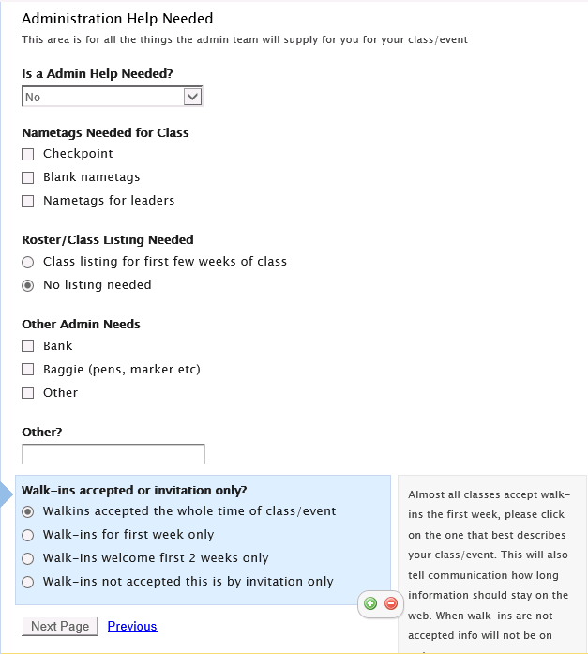
Filling out the form,
Trying to do checkpoint for most classes.

Slide 17
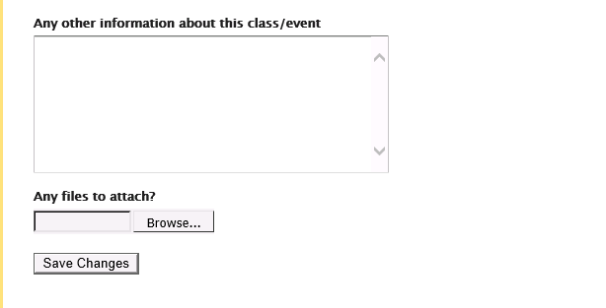
Filling out the form,
Please write in all other details about the event/class you didn’t add above, as much detail will help ensure things go well.
Don’t forget to hit submit!

Slide 18
What happens to the form when I hit submit?
Goes to Gail or Melissa
Farms out to all ministries you have asked for help from
Communication (give description)
Nursery (wait for ok)
Fellowship (Matt will contact you)
Production (Mike S will contact you)

Slide 19
What happens to the form when I hit submit?
Café Hope (Cindy will order)
Admin (will get a room, registration, copy form to shared drive, make sure on monitor, get checkpoint set up, email you with details when done).
Web (will put information from Communication and registration link on navigatehope

Slide 20
Looking for a copy of the genesis form you filled out with all the change requests?
All are listed with changes added in red at the bottom on the shared drive.
Shared/administration/genesis/season
(class will be in folder of the first class so if year round in Fall folder)

Slide 21
Genesis Forms are Due
For Fall Classes due the first week of July
For Winter Classes (up to Easter) due in Nov.
For Spring/Summer Classes due in Feb.
Your next due date for the Spring Summer Classes this year is
Feb. 24
Class Listing will come out March 29/30

Slide 22
Need help?
Come talk with Gail or Carlie – we are here to help answer any questions. Our teams can also help you.
Email admin@hopewdm.org

