Slide 1
Email is NOT an Instant Form of Communication
(It can take some time)

Slide 2
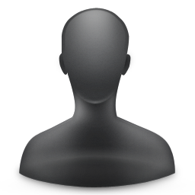
How Email Appears to Work
Sender’s Outbox
Recipient’s Inbox

Slide 3
How Email Really Works
Router
Router
Sender’s Outbox
Router
Router
Recipient’s Inbox
Router
Router
Company
Network
Company
Network
Router
Router
Firewall
Spam Filter
Sender’s Mail Server
Recipient’s Mail Server
Internet
Email Queue

Slide 4
Archived Email
No need to Auto-Archive old messages
PST do not get backed up

Slide 5
Attachments
Link to shared drive if only sending to staff
\\lcoh-file\shared\it\Voicemail Pro User Guide.pdf
Only open attachments you are expecting
Use common formats like PDF
Avoid Apple’s Pages and Microsoft Publisher

Slide 6
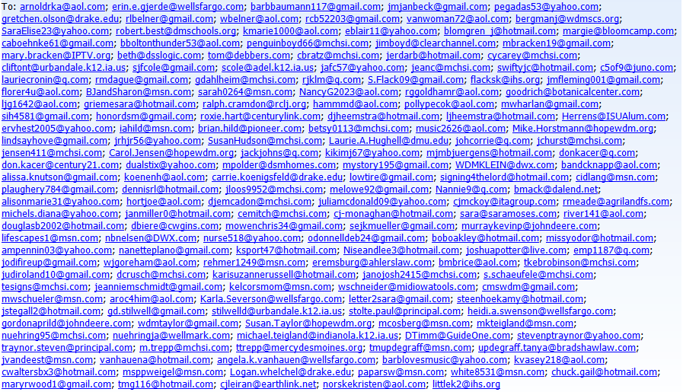
Recipients List

Slide 7
Sending out emails to more than 20-25 people?
Want to see how many open the email?
Want to add pictures, documents, or archive for the web?

Slide 8
What Account to use?
Volunteer emails - this is if you are sending out to any volunteer groups, fellowship, hospitality, outreach etc.
Newsletter emails – ONLY Communication uses this
Ministry Newsletters - this would be ministry updates, where people can opt in or out to receive. Includes: missions, revive, men’s, women’s, etc. Would include funeral emails.
Parent/Group & Leader Emails – for all the parents of, leaders of, like PowerLife leaders, Alpha Hosts, parents of KQ, 1st communion email to parents, etc.

Slide 9
Who creates?
To all leaders or volunteer groups you lead – ministry creates.
To all members, parents of, ministry news – Communication creates/proofs

Slide 10
Have an email to send?
Send the body of email to communication@hopedm.org
Send any pictures or details about the email.
Who is it going to?
Need about 2 weeks to create and send out.

Slide 11
Contact Lists
Admin will pull all lists if you create the email please ask for the contact list at admin@hopewdm.org – at least 1-2 days before.
Once a month all lists will be deleted so everything must be in ACS for easy pull.

Slide 12
When can emails go out?
Monday, Tuesday or Wednesday only.
Thursday – for all church email
Friday – for Pr Mike email
Weekend – worship info only

